Slide 1
Deep Learning Introduction
Ari Weinstein
Ellison Institute of Technology

Slide 2
Lecture Outline
Introduction
Theoretical Intuition
Core Building Blocks
Training Dynamics & Debugging, AdamW
Advanced Issues

Slide 3
Introduction
Goal is to ensure common core understanding:
  What is needed for deep learning (DL) to work
  DL building blocks that accomplish this
Other lectures will focus on advanced topics (vision, sequence/text, reinforcement learning)
Assume basic knowledge on feedforward networks and backprop
This is a survey; goal is to give you some knowledge and you can dig into areas as needed later
Notes:
Assuming basic feedforward/backprop knowledge
but focusing on what makes deep nets actually train.
Frame the course: “Deep learning is less about fancy math, more about careful engineering of optimization stability.”

Slide 4
Case Study: LeNet vs AlexNet (Introduction)
What was needed to get deep learning to work
There was a period of great excitement around NNs (late 80s-90s)
  But early progress didn’t continue, and approach was largely ignored
 | LeNet-5 | AlexNet
When | 1998 | 2012
Classification | 10 (digits) | 1K (natural images)
Parameters | 60K | 60M
Corpus | 60K b/w | 1.2M rgb
Activation | tanh | relu
Regularization | none | dropout
Compute | CPU | GPU
Notes:
Explain the “AI winters” and why LeNet couldn’t scale — small data, slow hardware, poor regularization.
AlexNet (2012) worked because of GPUs, ReLUs, dropout, and data augmentation.
Connect to your later sections: “These are exactly the ideas we’ll unpack today — normalization, regularization, better optimization.”

Slide 5
Deep Learning in the past 10+ years (Introduction)
Huge increase in data
Huge advances in computational hardware for these models
  New architectures that work well on hardware (ex/ transformers vs RNN)
Controlling model complexity (regularization)
Controlling activations and gradients (normalization)
Not much in the way of meaningful science or mathematical advances

Slide 6
Theoretical Intuitions
Bias/Variance Tradeoff: model complexity and fit
  Addressed by regularization
Exploding/Vanishing Gradients: keeping DL machinery working
  Addressed by normalization

Slide 7
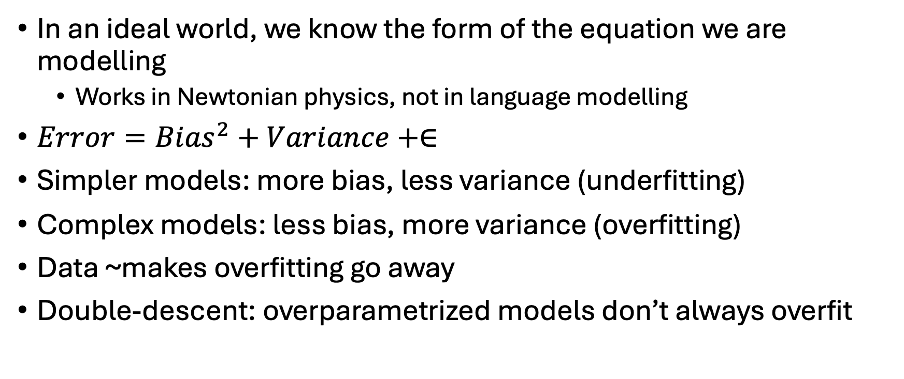
Bias/Variance Tradeoff (Theoretical Intuitions)
In an ideal world, we know the form of the equation we are modelling
  Works in Newtonian physics, not in language modelling
$Error={Bias}^{2}+Variance+∈$
Simpler models: more bias, less variance (underfitting)
Complex models: less bias, more variance (overfitting)
Data ~makes overfitting go away
Double-descent: overparametrized models don’t always overfit
Notes:
In modern deep networks — and even simpler models like random forests or kernel regressors — people observed something weird:
As model capacity continues to grow beyond the point of zero training error,
test error starts to drop again.
That’s the double descent curve:
In overparameterized models, the loss surface becomes flatter and has many equivalent global minima.
SGD tends to converge to flat minima, which correspond to low generalization error.
In the first descent, regularization matters: too few parameters → underfit.
Near the interpolation threshold, test error peaks: high variance, unstable.
In the second descent, massive overparameterization smooths things again:
the model generalizes well despite perfect fit to training data.
This explains why modern models with billions of parameters can still generalize well on natural data.

Slide 8
Regularization (Theoretical Intuitions)
Because of bias/variance tradeoff, in naïve modelling there is U-shaped profile of accuracy across model complexity
Ideally, modelling would control complexity and try to find the sweet spot by itself
There is a whole literature on regularization, we heavily rely on
  Dropout (especially useful in lower-data regimes)
  Weight decay in AdamW (L2 regularization)
Data augmentation
Notes:
Add context: dropout encourages redundancy and robustness; weight decay discourages high-capacity memorization; data augmentation acts as implicit regularization.
Mention AdamW specifically: it decouples weight decay from adaptive updates, preserving true L2 regularization.
Techniques to prevent overfitting
Important in data-sparse settings
Biases optimization to simpler functions
Dropout
Less common as datasets get gigantic
L1/L2 penalties
AdamW weight decay ~ L2 regularization
Data augmentation

Slide 9
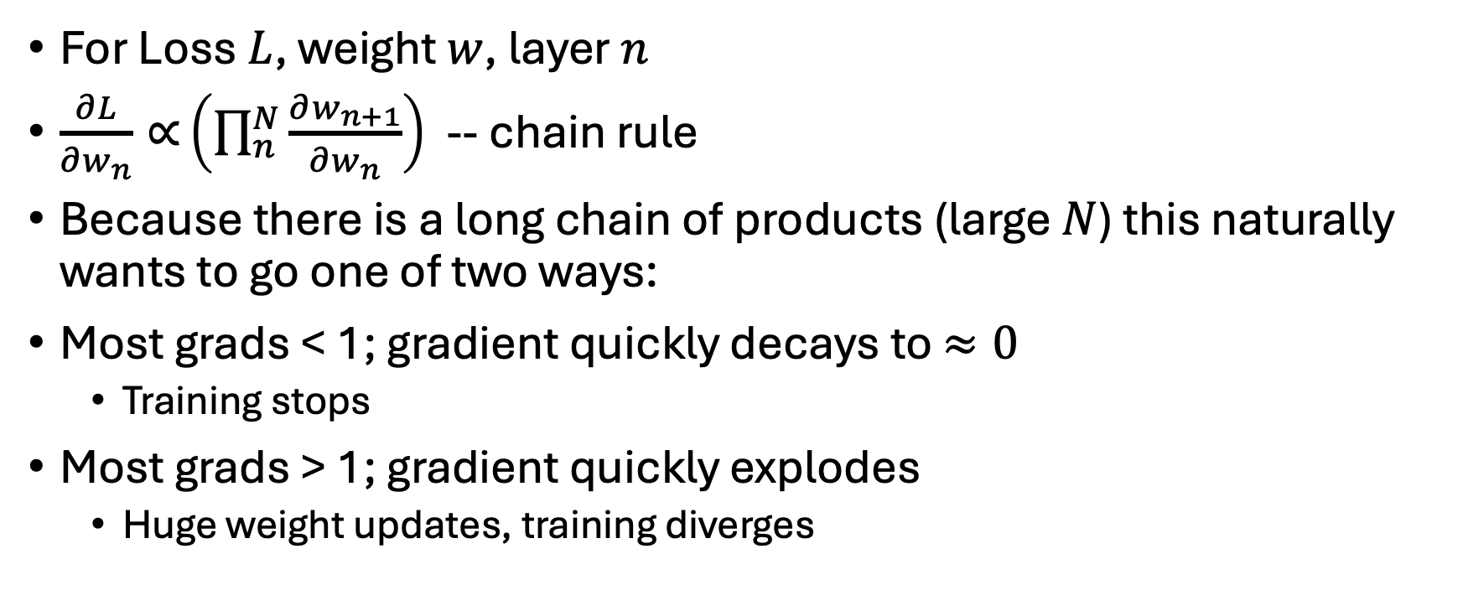
Vanishing, Exploding Gradients (Theoretical Intuitions)
For Loss $L$, weight $w$, layer $n$
$\frac{∂L}{∂w_{n}}{∝}\left(\prod_{n}^{N}{\frac{∂w_{n+1}}{∂w_{n}}}\right)$ -- chain rule
Because there is a long chain of products (large $N$) this naturally wants to go one of two ways:
Most grads < 1; gradient quickly decays to $≈0$
  Training stops
Most grads > 1; gradient quickly explodes
  Huge weight updates, training diverges
Notes:
Stress this is the root reason deep networks were unstable before ~2010.

Slide 10
Core Building Blocks
Activation Functions
  How can we make sure activations propagate forward, gradients propagate backward effectively
Normalization
  How to speed and stabilize training

Slide 11
Activation Functions (Core Building Blocks)
In practice, extremely simple change was a key to modern DL
Sigmoid/Tanh, were used, but suffered from vanishing gradients
ReLU can fixes this, but has other problems
Swish, Swiglu : How can we take the advantages of ReLUs but further improve
Bonus: Residual Connections: Solution to gradient flow issues

Slide 12
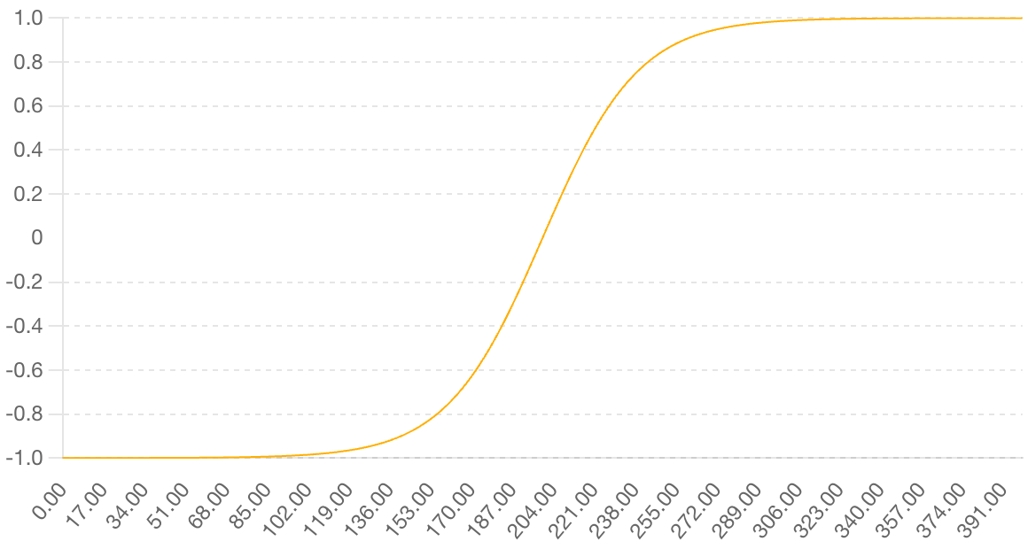
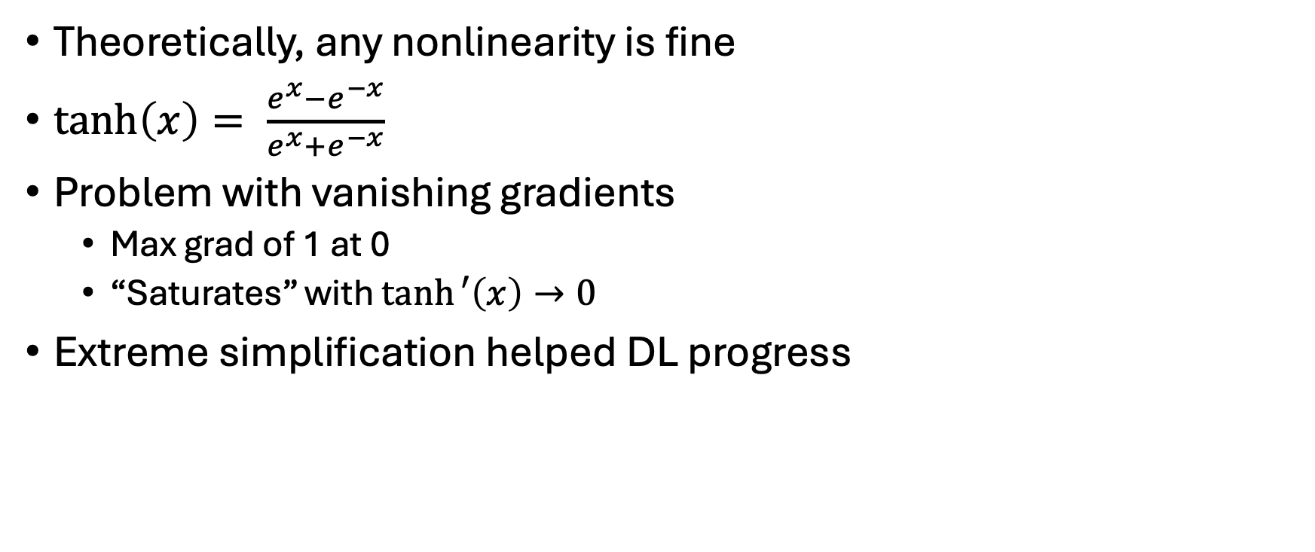
TanH (Activation Functions)
Theoretically, any nonlinearity is fine
$\tanh\left(x\right)= \frac{e^{x}−e^{−x}}{e^{x}+e^{−x}}$
Problem with vanishing gradients
  Max grad of 1 at 0
  “Saturates” with $\tanh{′\left(x\right)}→0$
Extreme simplification helped DL progress
Notes:
The move from sigmoid/tanh to ReLU as the “turning point” in DL.

Slide 13
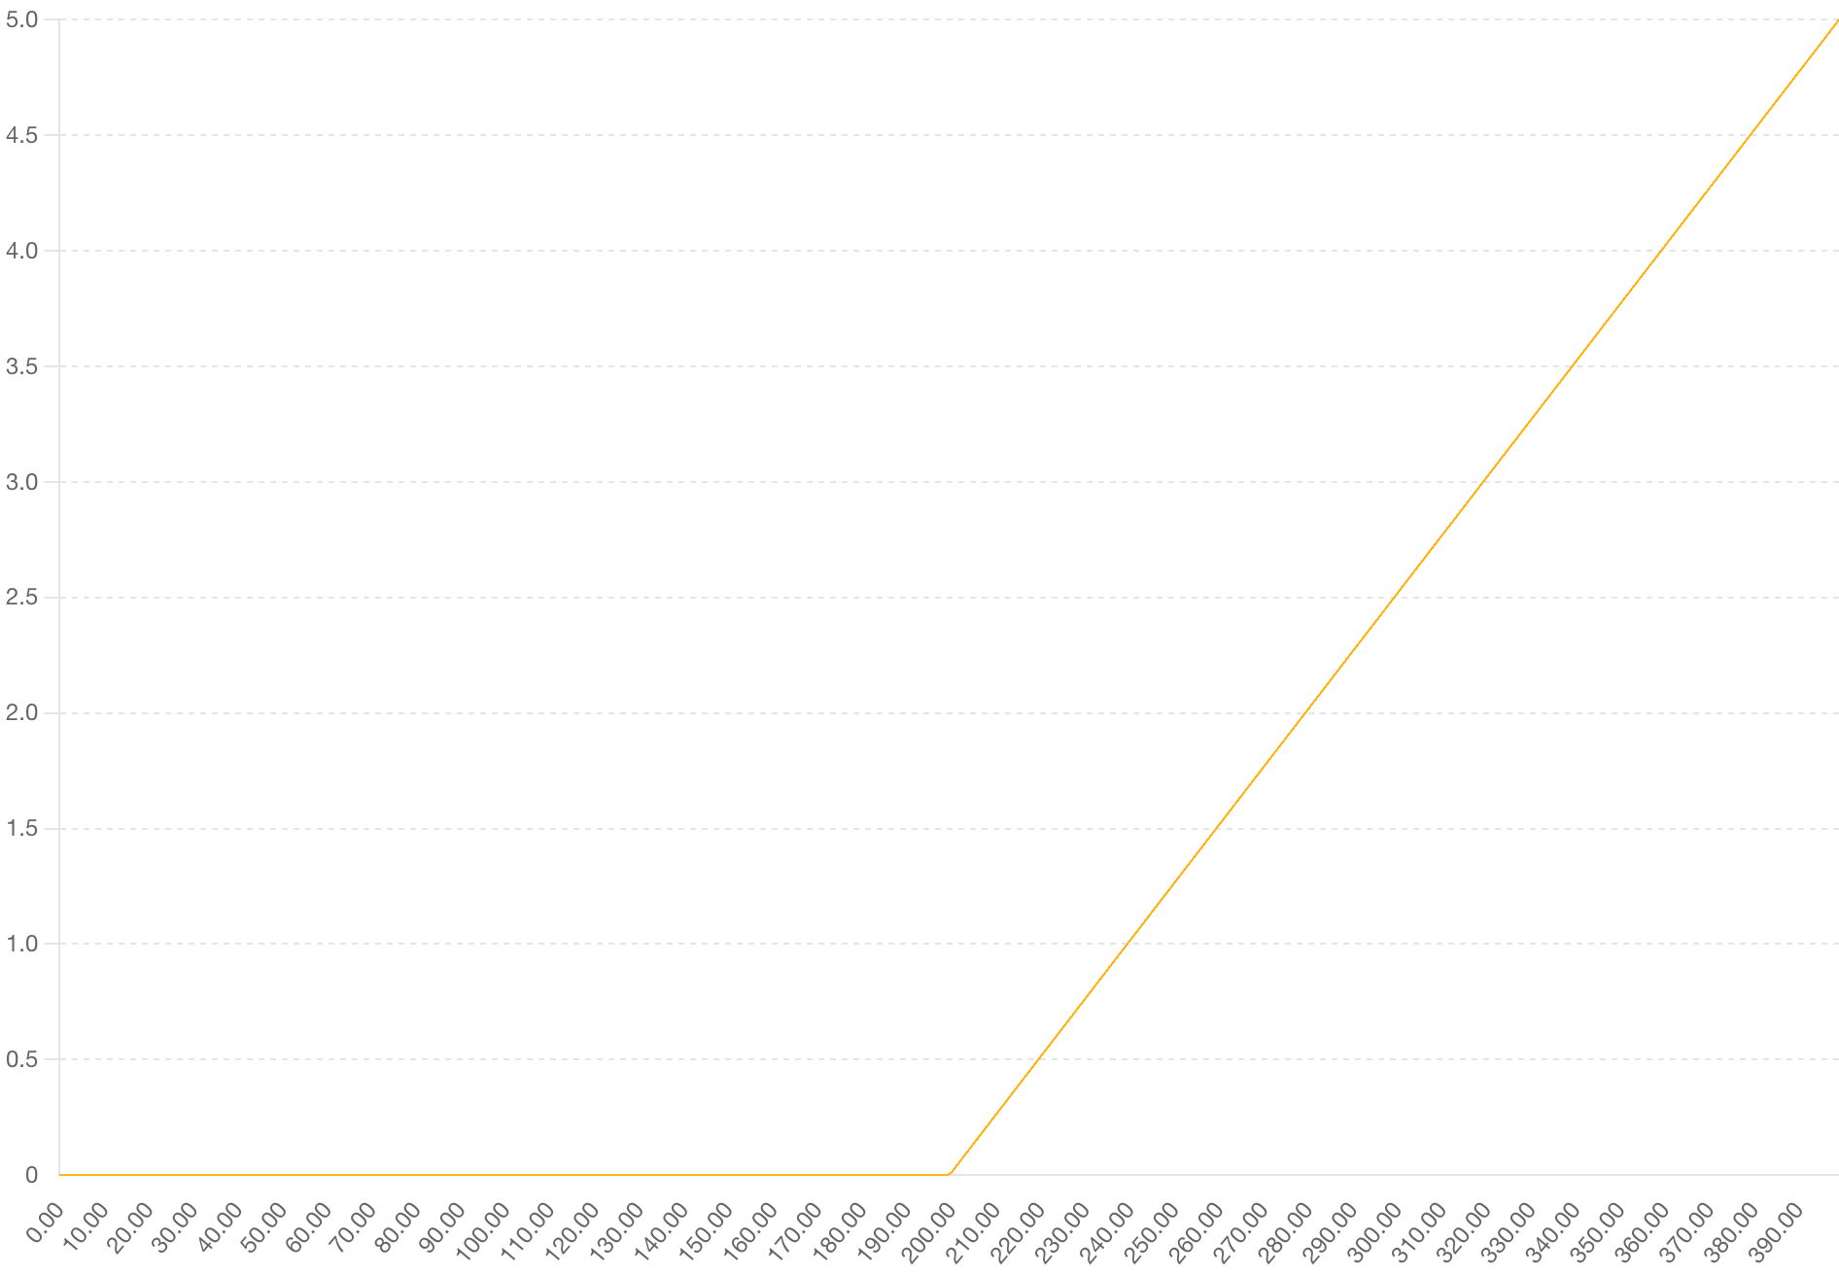
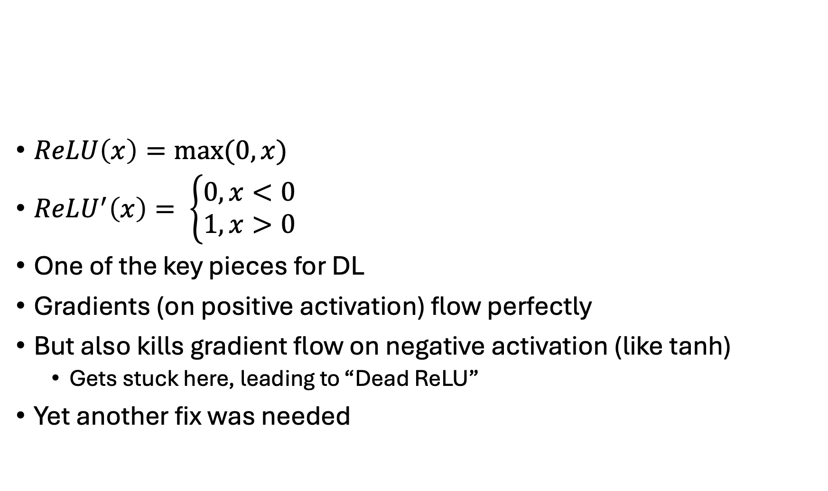
Recitified Linear Unit (Activation Functions)
$ReLU\left(x\right)=max⁡(0,x)$
$ReLU^{′}\left(x\right)= \left\{\begin{aligned}0, x<0 \\ 1, x>0\end{aligned}\right.$
One of the key pieces for DL
Gradients (on positive activation) flow perfectly
But also kills gradient flow on negative activation (like tanh)
  Gets stuck here, leading to “Dead ReLU”
Yet another fix was needed

Slide 14
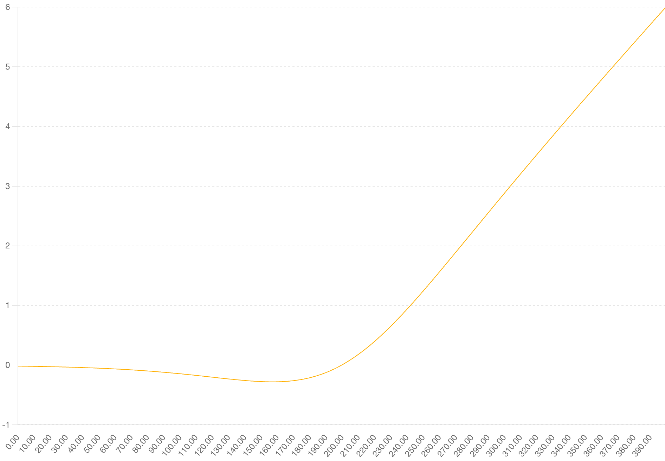
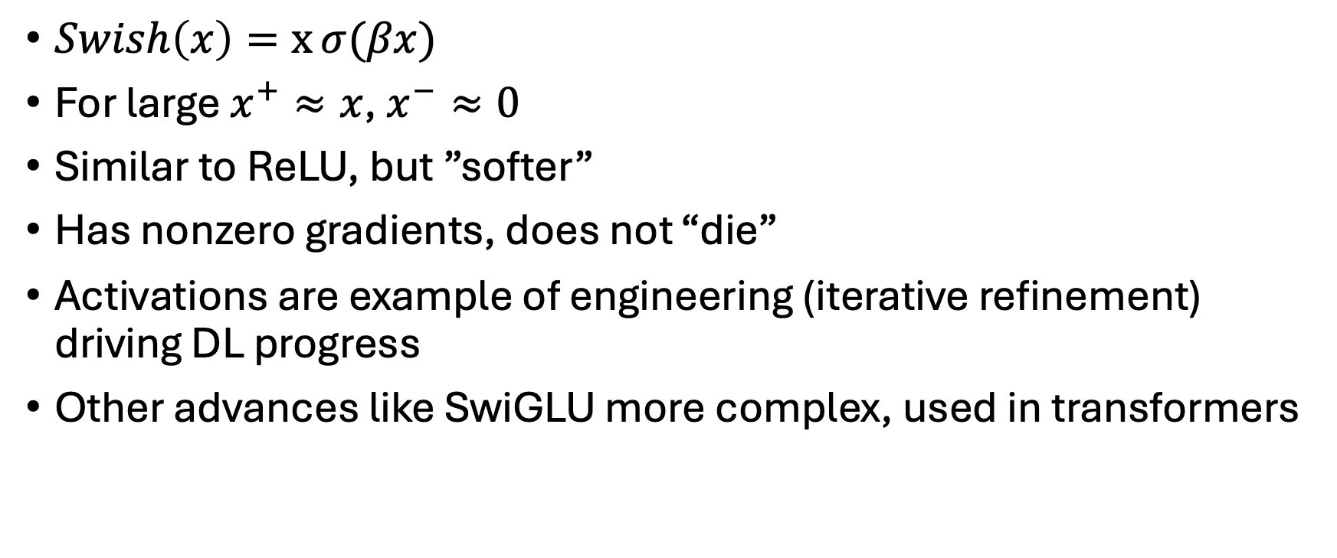
Swish (Activation Functions)
$Swish\left(x\right)=x⁡σ(βx)$
For large $x^{+}≈x$, $x^{−}≈0$
Similar to ReLU, but ”softer”
Has nonzero gradients, does not “die”
Activations are example of engineering (iterative refinement) driving DL progress
Other advances like SwiGLU more complex, used in transformers

Slide 15
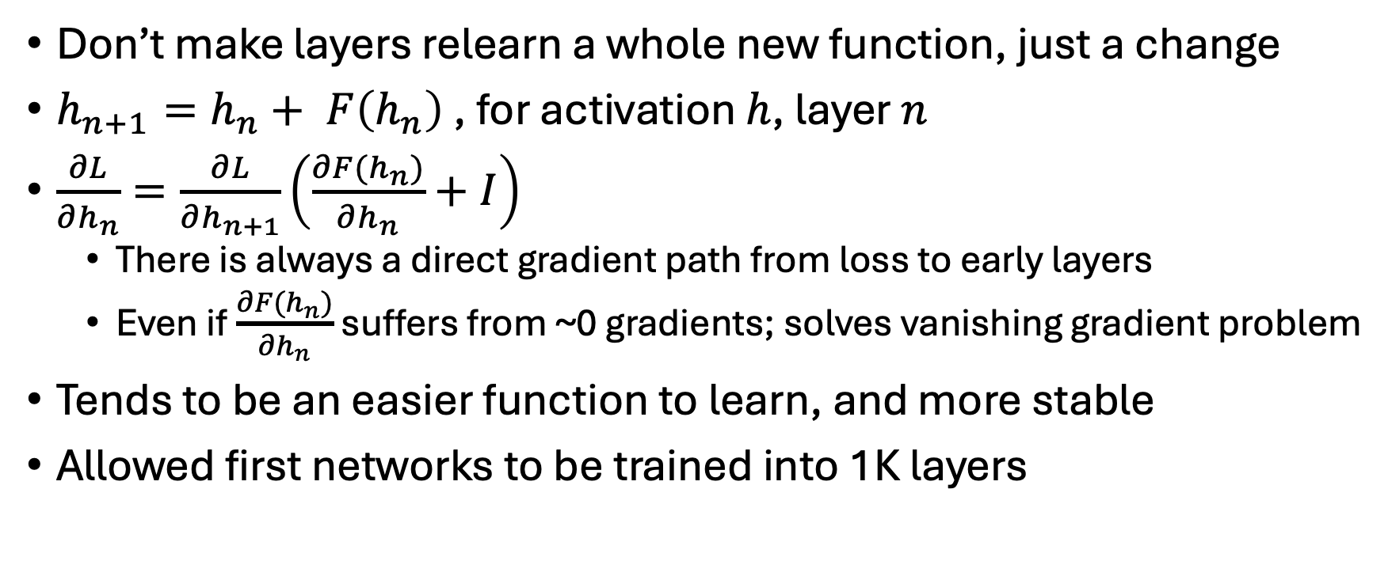
Residual Connections (Core Building Blocks)
Don’t make layers relearn a whole new function, just a change
$h_{n+1}=h_{n}+ F\left(h_{n}\right)$ , for activation $h$, layer $n$
$\frac{∂L}{∂h_{n}}=\frac{∂L}{∂h_{n+1}}\left(\frac{∂F(h_{n})}{∂h_{n}}+I\right)$
  There is always a direct gradient path from loss to early layers
  Even if$\frac{∂F(h_{n})}{∂h_{n}}$ suffers from ~0 gradients; solves vanishing gradient problem
Tends to be an easier function to learn, and more stable
Allowed first networks to be trained into 1K layers

Slide 16
Normalization (Core Building Blocks)
Forces activations to be of a consistent distribution
Helps resolve vanishing/exploding gradients (activations are never overall too big or small)
  Easier to train deep nets
Helps early in training where dynamics can be unstable
Reduces the need for careful initialization
BatchNorm, LayerNorm, RMSNorm

Slide 17
Different forms (Normalization)
Batch Norm: normalizes activations of a single neuron in a batch to have zero mean, unit variance
  More common in CNNs w/large bactches
Layer Norm: normalizes the activation of a single sample across a layer
  Common in Transformers (smaller batch sizes)
RMS Norm: Similar to Layer Norm but simpler
  Most modern transformers use this, as cheaper to compute

Slide 18
Regularization (Core Building Blocks)
Techniques to prevent overfitting
  Important in data-sparse settings
Biases optimization to simpler functions
Dropout
  Less common as datasets get gigantic
L1/L2 penalties
AdamW weight decay ~ L2 regularization
Data augmentation

Slide 19
Outline: Training Dynamics and Optimizers
Initialization: Setting your network up for success
Optimizers (AdamW)
Learning Rate Schedules:
When Training Goes Wrong: Numeric and other Issues

Slide 20
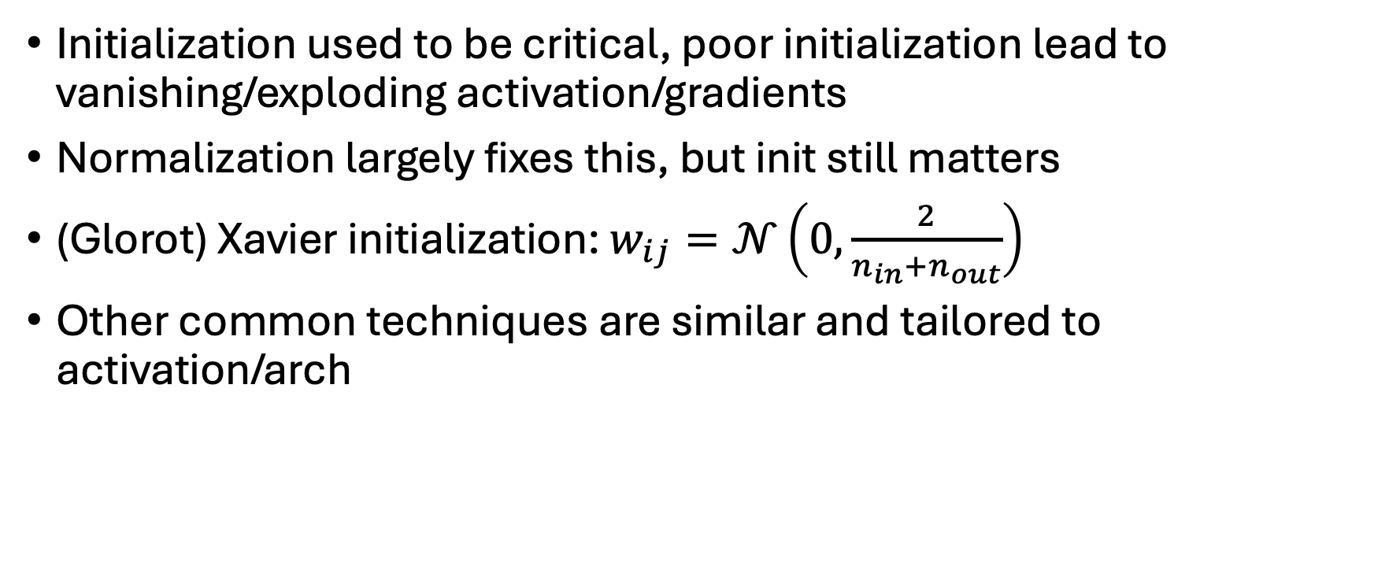
Initialization (Dynamics, Optimizers)
Initialization used to be critical, poor initialization lead to vanishing/exploding activation/gradients
Normalization largely fixes this, but init still matters
(Glorot) Xavier initialization: $w_{ij}=𝒩\left(0, \frac{2}{n_{in}+n_{out}}\right)$
Other common techniques are similar and tailored to activation/arch
Notes:
Why initialization is important for forward and backward passes early in training

Slide 21
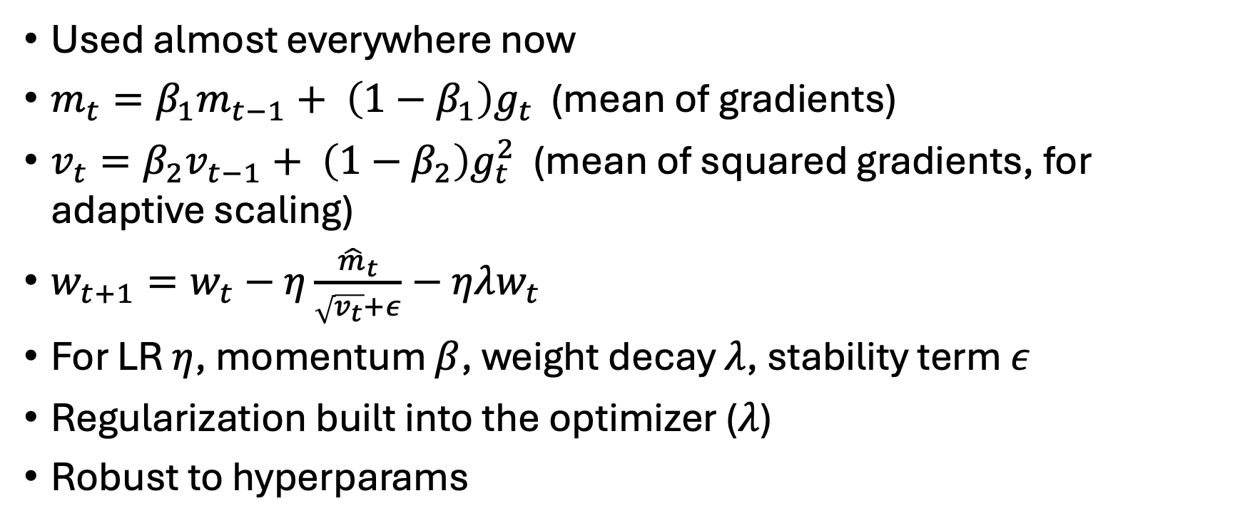
AdamW (Dynamics, Optimizers)
Used almost everywhere now
$m_{t}=β_{1}m_{t−1}+ \left(1−β_{1}\right)g_{t}$ (mean of gradients)
$v_{t}=β_{2}v_{t−1}+ \left(1−β_{2}\right){g_{t}^{2}}_{ }$ (mean of squared gradients, for adaptive scaling)
$w_{t+1}=w_{t}−η\frac{{\hat{m}}_{t}}{\sqrt{v_{t}}+ε}−ηλw_{t}$
For LR $η$, momentum $β$, weight decay $λ$, stability term $ε$
Regularization built into the optimizer ($λ$)
Robust to hyperparams

Slide 22
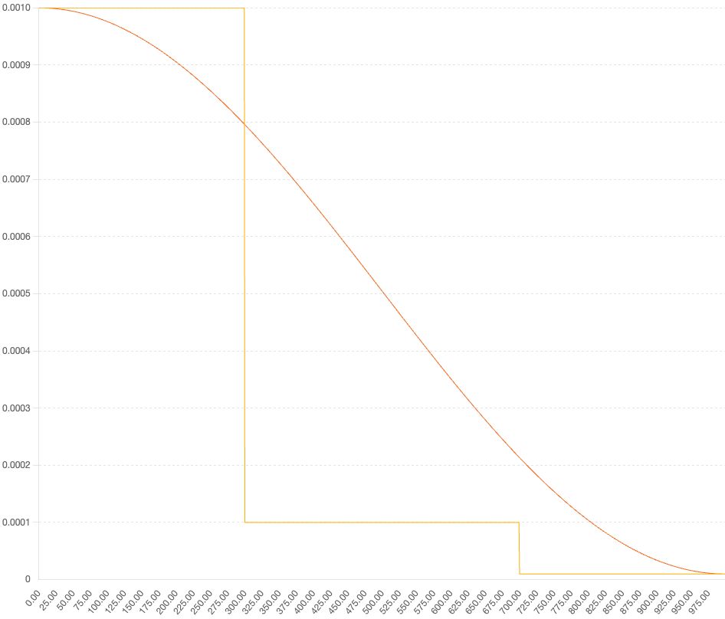
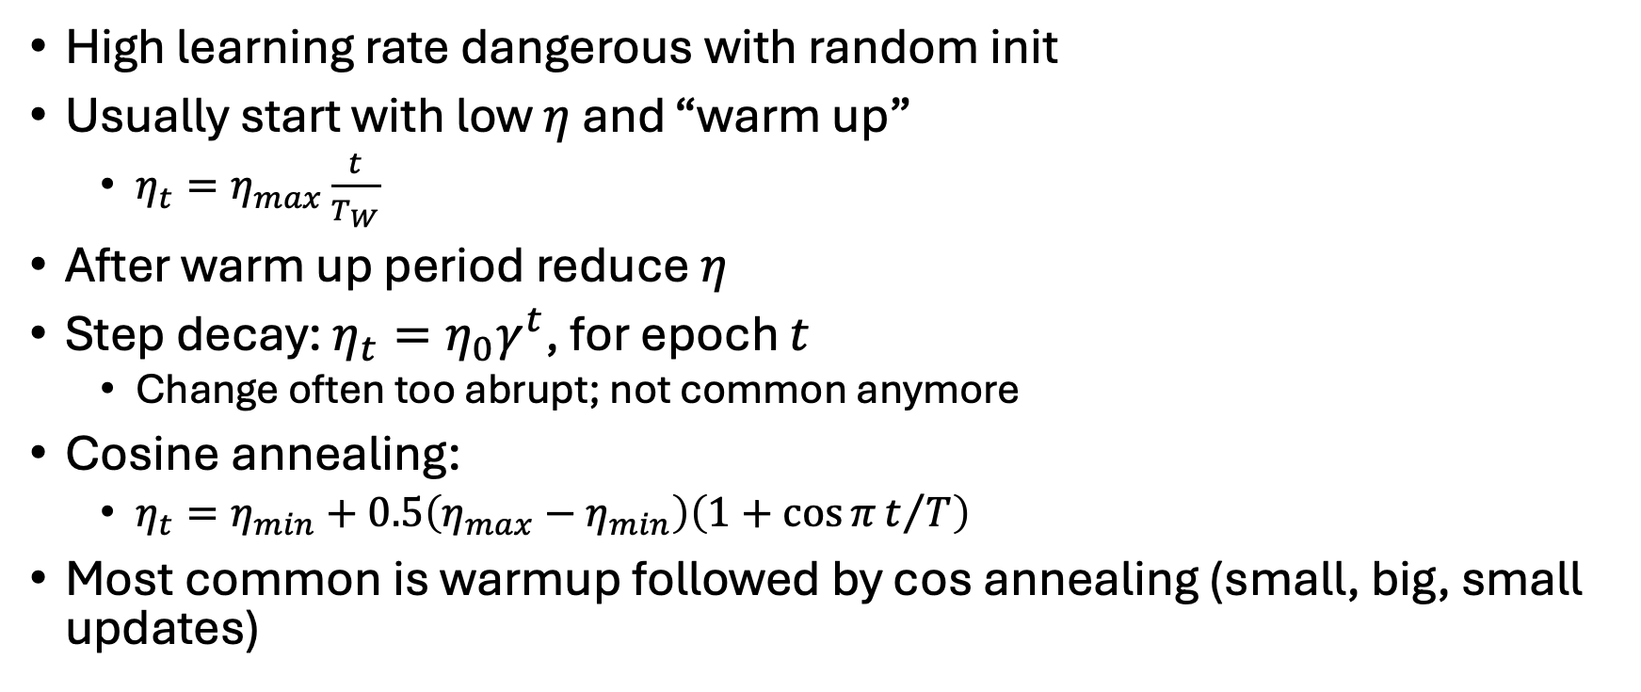
Learning Rate Schedules (Dynamics, Optimizers)
High learning rate dangerous with random init
Usually start with low $η$ and “warm up”
  $η_{t}=η_{max}\frac{t}{T_{W}}$
After warm up period reduce $η$
Step decay: $η_{t}=η_{0}γ^{t}$, for epoch $t$
  Change often too abrupt; not common anymore
Cosine annealing:
  $η_{t}=η_{min}+0.5\left(η_{max}−η_{min}\right)\left(1+\cos{π}t/T\right)$
Most common is warmup followed by cos annealing (small, big, small updates)

Slide 23
Numerics (Generalization & Advanced Issues)
Can be hard to track down (use tooling)
Computers store approximations of reals, can go wrong
  Overflow (becomes inf), underflow (becomes 0), ruins gradients
Issues can arise at any point (early, late in training)
Use gradient clipping, loss scaling, check for NaN and inf
When developing, make smaller nets with large representations (float32), then move to experimenting with less/mixed precision on larger networks
Get shallow wide nets to work, then go deeper
Notes:
Michael Littman wake before dividing by zero

Slide 24
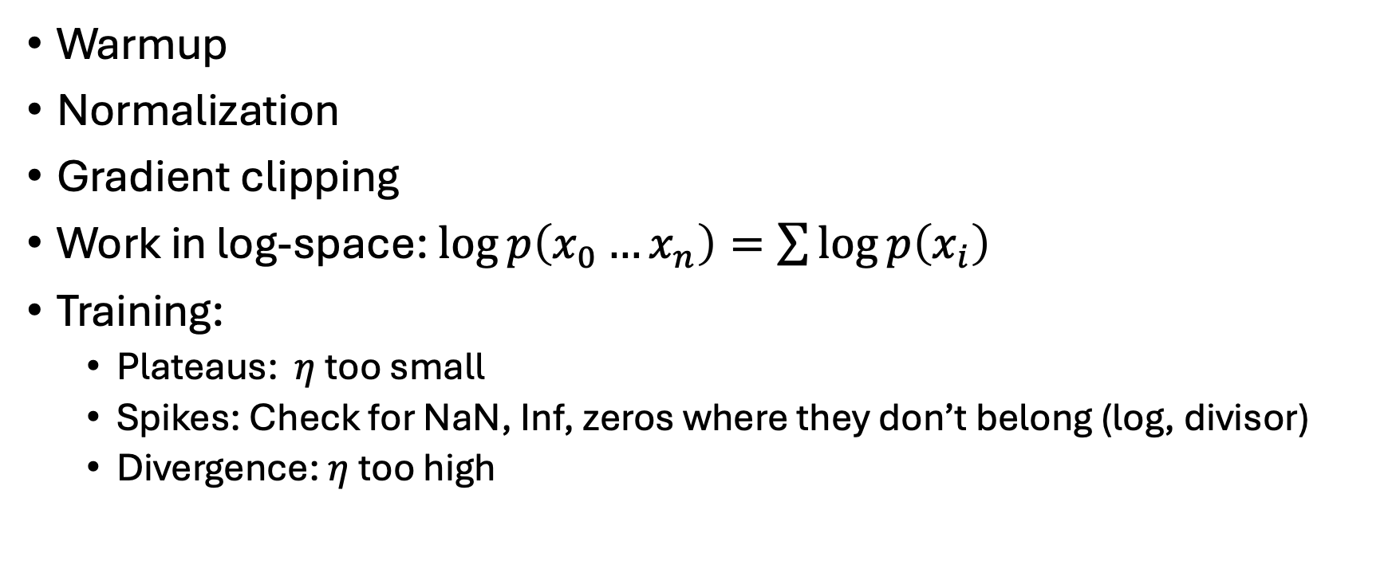
Numerics (Generalization & Advanced Issues)
Warmup
Normalization
Gradient clipping
Work in log-space: $\log{p\left(x_{0}…x_{n}\right)}=\sum{\log{p\left(x_{i}\right)}}$
Training:
  Plateaus: $η$ too small
  Spikes: Check for NaN, Inf, zeros where they don’t belong (log, divisor)
  Divergence: $η$ too high

Slide 25
Debugging Checklist
Make sure any data can run through model and produce gradient
If dataset is not vetted, check data cleanliness (inf, Nan, missing val, ranges)
Overfit tiny subset of data
Go from small to large learning rates during testing
Examine gradient norms, especially early in training
  If large, use normalization, gradient clipping

Slide 26
Outline: Advanced Topics
Real-World Data Issues
  When life isn’t as easy as MNIST
Representation Learning
Fine Tuning

Slide 27
Real-World Data Issues (Advanced Topics)
Increasingly important as DL systems are in use in society
IID assumption is core in ML often doesn’t hold
Importance of diverse / representative data
Data balance
Error types (type 1 vs 2)
Data pedigree
Train/test split, data leakage
Calibration
Runaway feedback loops

Slide 28
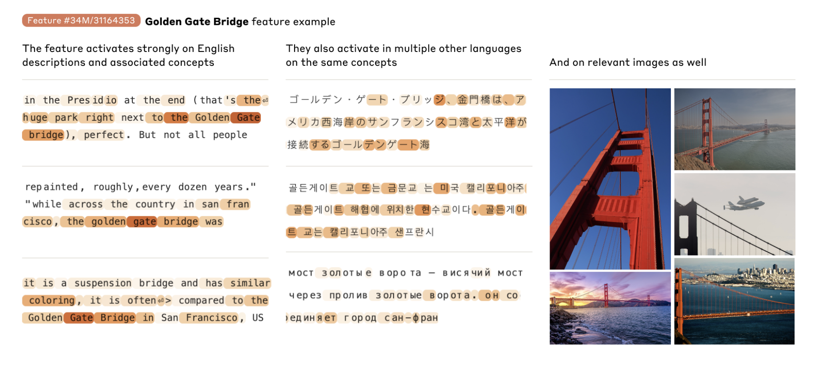
Representation Learning (Advanced Topics)
Fundamental strength of deep learning is ability of models to learn meaningful representations of data
Take potentially disparate modalities of data and produce rich and meaningful vector embeddings
Scaling Monosemanticity: Extracting Interpretable Features from Claude 3 Sonnet

Slide 29
Representation Learning (Advanced Topics)
Good representations allow for robust generalization
Enables broad downstream use, and efficient fine tuning
In modern techniques, driven primarily by unsupervised learning
  Autoregressive prediction
  Contrastive encoding
What makes foundation models so flexible and powerful

Slide 30
Fine Tuning (Advanced Topics)
Increasingly important, as foundation models dominate modern ML
Sometimes you can’t zero-shot your way to what you want
  Ex/ RL loops for LLM coding
Usually no need to tune entire model
  LoRA & others allow fine-tuning tiny amount of params
  Helpful when Hardware isn’t same as original training
Often only small amount of data is needed

Slide 31
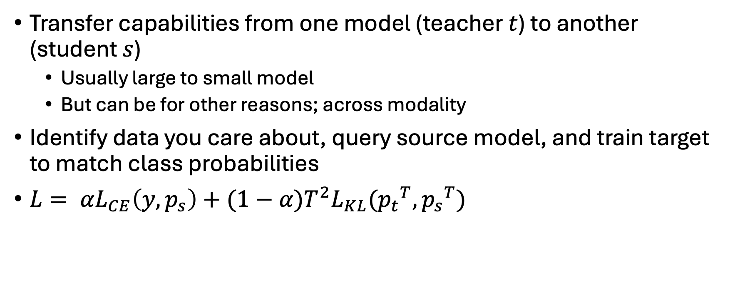
Distillation
Transfer capabilities from one model (teacher $t$) to another (student $s$)
  Usually large to small model
  But can be for other reasons; across modality
Identify data you care about, query source model, and train target to match class probabilities
$L= αL_{CE}\left(y, p_{s}\right)+(1−α)T^{2}L_{KL}({p_{t}}^{T}, {p_{s}}^{T})$
Notes:
Can work better than reducing precision; sometimes need more reduction than that

Slide 32
Advanced Concepts [TBD]
Learning good representations
Knowledge distillation
Detecting and alleviating biases in models

Slide 33
Conclusion
Discussed:
  Fundamentals
  Building blocks
  Training & Numerics
  Important considerations
  Advanced topics
Please feel free to reach out to me at aweinstein@eit.org!
Please ask questions!

